Slide 1
Final
Presentation
Done by: G1T3

Slide 2
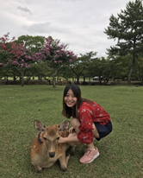
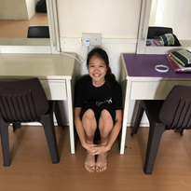

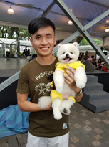
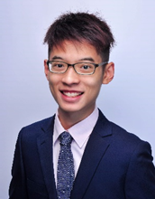
Hello!
We are Team NO S.I.S
Joleen
Amanda
Shreyas
Joel
Ming Xuan

Slide 3









Contents
Schedule
Improvements
Work Breakdown
Metrics
GIT Usage
Test Score
Server Info
Main Takeaways

Slide 4

Schedule
Broad Iteration Timeline

Slide 5
Timeline Overview
Iteration 1
Iteration 2
Iteration 3
Planning
Design Diagrams
Design Metric
Develop Critical Plans
Login Authentication function development
Bootstrap & Upload function development
Supervisor Meeting 1
Top K popular places function development
Student breakdown function development
Web UI
JSON Login Authenticate
PM Review
AWS Deployment
Iteration 1
Iteration 2
Iteration 3
HTML, Bootstrap and JSP sharing session added
PM Review Preparation added
Coding of basic entity and DAO
Bootstrap & Upload function development (Spillover)
Database Connection Properties
Breakdown Utility class creation
Time Utility class creation
Planned
Changes

Slide 6
Timeline Overview
Iteration 4
Iteration 5
Iteration 6
Iteration 7
Heatmap function development
Automated Group Detection function development
JSON bootstrap
JSON Student breakdown report
Supervisor Meeting 2
Top K next places report function development
Top K companions report function development
JSON Heatmap
JSON AGD
JSON Top K reports
Application demo
Web UI
UAT
Debugging
Submission
Final Presentation
Iteration 4
Iteration 5
Iteration 6
Iteration 7
Student breakdown function development (Spillover)
Top K popular places report function development (Moved from iteration 3)
UAT
Debugging
Mock Q&A
Submission
Final Presentation
Planned
Changes

Slide 7






Functionalities
Login
Bootstrap
Heatmap
Basic Location Reports
Automatic Group Detection
Dual User Interfaces (UI and JSON)
No functionalities dropped!

Slide 8

Frameworks and External Libraries
1.-
Framework used
MVC
2.-
External libraries used
OpenCSV
Gson
UploadBeans
IS203JWT

Slide 9
Problems faced while tracking schedule
S/N | ISSUE | SOLUTION
1 | Changes of deadline in IS203 Wikipedia would result a shift in schedule | PM to check Wikipedia history every 2-3 days and updates team in case of any updates.
2 | Spill over tasks from previous iteration | PM has to reschedule iteration and needs to track team’s progress due to the urgency of completing spill over tasks.
3 | Personal timings and tests do not meet planned task’s start and end date time | Individuals in the group would have to inform the PM beforehand and PM when tasks are completed. PM will reallocate tasks to others if required.
4 | Group members are not aware of the group’s iteration progress | PM will give an overall status summary of the iteration tasks to the group via Telegram at the day 7 and day 10.

Slide 10
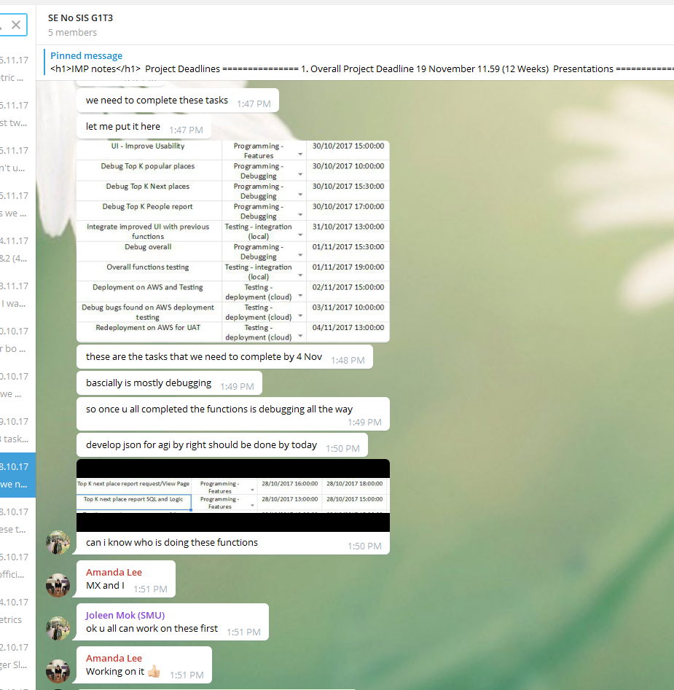
How we overcame schedule tracking issues (Example)
PM will give an overall status summary of the iteration tasks to the group via Telegram.
Iteration 5, PM: Joleen

Slide 11
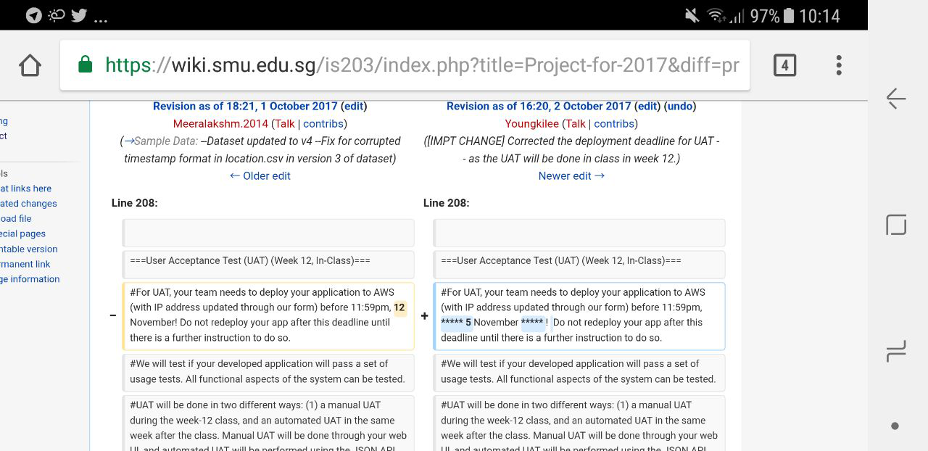
How we overcame schedule tracking issues (Example)
PM to check Wikipedia history every 2-3 days and updates team in case of any updates.
Iteration 3, PM: Amanda

Slide 12
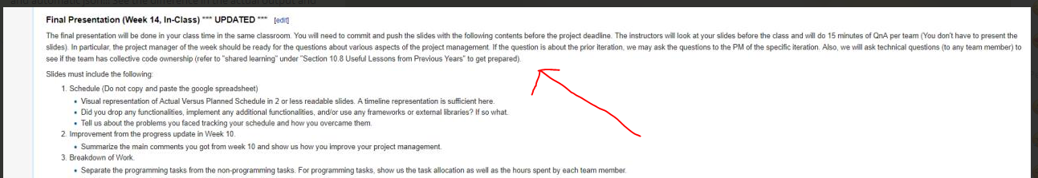
How we overcame schedule tracking issues (Example)
PM to check Wikipedia history every 2-3 days and updates team in case of any updates.
Iteration 6, PM: Shreyas

Slide 13
Improvements
From Week 10

Slide 14
Improvements
Summary of comments from Professor Yong Ki
Team is on track with the project Very good plan for future PP allocation to allow members with low PP hours to catch up Keep up on what we have been doing
What the team did
We kept track of the team’s project progress and make sure tasks are done within the Iteration to avoid further spill overs. We keep track of PP hours and allow members with lower PP hours to PP together to catch up The team avoid delaying the completion of critical tasks to stay on track.

Slide 15
Work Breakdown
Programming and Non-programming tasks

Slide 16
Task Distribution
(Programming task)
Functions | Joel | Shreyas | Ming Xuan | Amanda | Joleen
Login Authentication |  |  |  | ✓ | ✓
Bootstrap | ✓ |  | ✓
Validations of csv files | ✓ |  |  |  | ✓
Student breakdown report |  | ✓ | ✓
Heat Map |  | ✓ |  |  | ✓
Automated Group Identification | ✓ |  |  | ✓
Top K next places report |  |  | ✓ | ✓
Top K popular places report |  |  | ✓ | ✓
Top K companions report | ✓ | ✓
UI – Develop |  | ✓ | ✓

Slide 17
Task Distribution
(Programming task)
Functions | Joel | Shreyas | Ming Xuan | Amanda | Joleen
JSON Login | ✓ |  |  |  | ✓
JSON Bootstrap & Update | ✓ |  |  | ✓
JSON Student Breakdown report |  | ✓ |  |  | ✓
JSON Heatmap | ✓ | ✓
JSON AGD |  |  | ✓ | ✓
JSON Top K Popular Places |  |  | ✓ | ✓
JSON Top K Next Places |  |  | ✓ | ✓
JSON Top K Companions | ✓ | ✓
UI – Improve Usability | ✓ |  | ✓
Java Doc | ✓ |  |  |  | ✓

Slide 18
Workload Distribution
 | Total | AVG | Min | Max
Programming | 298.19 | 59.63 | 56.12 | 65.36
Non-programming | 234.27 | 46.85 | 43.57 | 49.75
Total hours | 532.47 | 106.48 | 99.69 | 115.1

Slide 19
Workload Distribution

Slide 20
Metrics
Task and Bug

Slide 21
Task Metrics
Iteration | 1 | 2 | 3 | 4 | 5 | 6
Score | 120% | 83% | 92% | 94% | 107% | 100%
Action Done | Our group's progress was relatively well done, our group decided that we could increase the number of tasks in the next iteration. | As some of these tasks were still undone from iteration 2, we had moved these spillover tasks to the next iteration. We also rearranged some of the functionalities that we wanted to carry out in iteration 3 to iteration 5 instead. | Our estimates are fairly accurate, the team are roughly on track. There are a few unplanned tasks that were created along the way, hence spilling over some tasks to the next iteration. Buffer days are sufficient | Our estimates are fairly accurate, the team are roughly on track. There was just one unplanned task. No spillovers. | Our estimates are fairly accurate, the team are roughly on track. | Our estimates are fairly accurate, the team are roughly on track.

Slide 22


Examples of followed up actions
At the end of iteration 1, Iteration 1 TM score: 120%
PM Shreyas decided to increase the amount of tasks for Iteration 2 from 16 to 18 tasks.
At the end of iteration 2, Iteration 2 TM score: 83%
As there were 4 spill over tasks from iteration 2 and iteration 3 has a lot of tasks to be completed, PM Amanda decided to shift the coding of Top K popular places function to iteration 5.

Slide 23
Bug Metrics

Slide 24
Bug Metrics
Iteration | Bug Metrics Points | Action Done
2 | 10 | Insert debugging sessions to resolve the bugs
3 | 41 | Insert debugging session after deployment to resolve the bugs
4 | 65 | Insert debugging session after deployment to resolve the bugs
5 | 200 | An emergency debugging session was added to update the code according to the change in wiki requirements before UAT. Debugging sessions were added to resolve bugs identified after manual and automated UAT.
6 | 130 | Bugs were identified during UAT and resolved in debugging sessions before the final deployment.
Total | 401

Slide 25
Examples of followed up actions
39 Bugs were found in Iteration 5.
PM Joleen decided to add two more debugging sessions to the two that was already planned in order to fix all the bugs.

Slide 26
Challenges faced
S/N | ISSUE | SOLUTION
1 | Delay In logging information into bug metrics as it may disrupts the flow of iteration | PM to remind team to consistently log any bugs they discovered during testing stages.
2 | Time consuming to collate and update metrics | PM is tasked to update the metrics and gather information from team members.
3 | Too many unplanned tasks in iteration | PM is to review the iteration schedule, deduct from buffer days and inform team.
4 | Rescheduling tasks in next iteration due to spill overs | PM is to estimate the amount of days required to complete spill over tasks and to reschedule tasks without disrupting the iteration flow.

Slide 27
GIT
Usage Demonstration

Slide 28
Use of GIT

Slide 29
Test Score
Expected Result

Slide 30
Expected Test score
 | Week 12 (UAT) |  | Week 14 (After Final Submission)
 | In-Class UAT Score | Automated UAT Score | Expected In-Class UAT Score | Expected Automated UAT Score
Bootstrap & Upload additional files | 0/3 | 0/2 | 3/3 | 2/2
Login | 2/3 | 1/2 | 3/3 | 2/2
Heatmap | 0/3 | 0/3 | 3/3 | 3/3
Breakdown report | 0/3 | 0/3 | 3/3 | 3/3
Top K reports | 0/8 | 3/8 | 8/8 | 8/8
Group detection | 0/4 | 0/4 | 4/4 | 4/4
Total | 2/24 | 4/22 | 24/24 | 22/22

Slide 31
Server Info
How To Reach Us

Slide 32



http://13.58.67.238/app/
Username: admin
Password: AdminPW

Slide 33
Key Takeaways
From the project

Slide 34





Main Takeaway from the team
Scheduling & detailed planning | The schedule provides the team a guideline to follow throughout the entire project duration. Tracking the schedule is also vital in meeting key milestones and to give the team a warning in case project schedule is derailing.
Fair allocation of work | The project is not a race but a marathon. By splitting the workload evenly in the team, it would make sure that the project is constantly progress and not tire one particular member out.
Effective Communication | Communication is key in passing key information within the team. Information should be documented for members that are not around for the meeting so they could be updated.
Follow the requirements of the project | One of the team member misinterpreted the project requirement and over validated the emails of the student. This resulted in a terrible UAT score by doing too much.
Always have a Mitigation Plan | The team identified the importance of having a mitigation plan in the project. Things usually don’t go smoothly as expected and it is important that we remain calm and find a viable option to overcome the obstacle.

Slide 35
Issues within the team
Issue | How we overcome it
Tight schedule among members | There are times where tasks are not completed as planned by the PM due to the busy schedules of the team members. We agreed in sacrificing personal time and find common timeslots to complete the task without causing much delay.
Vary strengths of each member | The team consist of members with various level of understanding of coding from IS200 and OOAD. The team decided to leverage on the strengths of each member and also did not leave anyone behind by helping those who are weak in programming.
Different personalities and communication styles within the group | Everyone in the group has a different working and communication preference. It will result in minor conflicts within the team when a member tried to prove his point across. The team decided on finding what works within the group and adopted our own group dynamics.
Different style of coding | There is a vast difference in style of coding by each team member. This resulted in overloading of methods by taking in different parameters to achieve similar goals. It could have been improved if we have better communications to decide on the exact methods and then modify the result after calling the method. We managed to accommodate to each other and minimize the overloading of methods by deciding which ones are more suitable.

Slide 36
Interesting facts within the group
Amanda is a very good pianist and holds a diploma in piano. She is a very good teacher as she teaches people piano and tuition in her free time!!
Shreyas is a foreign student from India. He has a sister working in Grab as an analyst and hopes to follow his sister’s steps. He’s only 20 this year!
Joel is the current Events Director for Ellipsis, the student body for SIS. He also enjoys playing the drums and is also part of SMU SAMBA MASALA.

Slide 37
Interesting facts within the group
Ming Xuan has a passion for dancing since JC and is currently in SMU Eurhythmix where he is the current Finance Director for the club
Joleen is a very sporty person and was involved in SMU trekking in the past. She has a keen interest in Marketing where she is currently pursuing a second major in!

Slide 38

Thank You!
Any Questions?

